Slide 1
Department of Applied Mathematics and Computational Sciences
III Sem M.Sc.Software Systems
Transform Techniques
Dr. V. Suresh kumar

Slide 2
Difference Equations

Slide 3

Definition: Difference equation
An equation involving the differences between successive values of a function of a discrete variable.
Examples
Consider an infinite sequence $\{y_{n}\}$, a difference equation corresponds to this sequence is
$$y_{n}=y_{n−1}+y_{n−2}$$

Slide 4







Solving difference equation
Solve the difference equation
$y_{n+2}={3y}_{n+1}−2y_{n}, y_{0}=0, y_{1}=1$
Ans:
Given
$$y_{n+2}={3y}_{n+1}−2y_{n}$$
and
$y_{0}=0, y_{1}=1$
$$y_{n+2}−{3y}_{n+1}+2y_{n}=0$$
$$𝒵\left\{x\left(n+1\right)\right\}=z𝒵\left\{x\left(n\right)\right\}−zx(0)$$
Taking Z Transform on both sides
$$𝒵\left\{x\left(n+2\right)\right\}=z^{2}𝒵\left\{x\left(n\right)\right\}−z^{2}x\left(0\right)−zx(1)$$
$$𝒵\{y_{n+2}−{3y}_{n+1}+2y_{n}\}=𝒵\{0\}$$
$$𝒵\{y_{n+2}\}−{3𝒵\{y}_{n+1}\}+2𝒵\{y_{n}\}=0$$
$$z^{2}𝒵\left\{y_{n}\right\}−z^{2}y_{0}−zy_{1}−3 \left[z𝒵\left\{y_{n}\right\}−zy_{0}\right]+2𝒵\left\{y_{n}\right\}=0$$

Slide 5






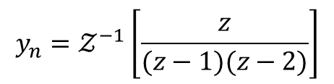
Problem contd…
$$z^{2}𝒵\left\{y_{n}\right\}−z^{2}y_{0}−zy_{1}−3 \left[z𝒵\left\{y_{n}\right\}−zy_{0}\right]+2𝒵\left\{y_{n}\right\}=0$$
$y_{0}=0, y_{1}=1$
$$z^{2}𝒵\left\{y_{n}\right\}−z(1)−3z𝒵\left\{y_{n}\right\}+2𝒵\left\{y_{n}\right\}=0$$
$$z^{2}𝒵\left\{y_{n}\right\}−3z𝒵\left\{y_{n}\right\}+2𝒵\left\{y_{n}\right\}=z$$
$${(z}^{2}−3z+2)𝒵\left\{y_{n}\right\}=z$$
$$𝒵\left\{y_{n}\right\}=\frac{z}{z^{2}−3z+2}$$
$$y_{n}=𝒵^{−1}\left[\frac{z}{z^{2}−3z+2}\right]$$
$$y_{n}=𝒵^{−1}\left[\frac{z}{(z−1)(z−2)}\right]$$
$$(1)$$

Slide 6
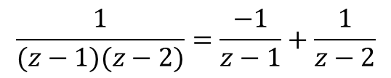

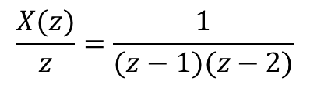


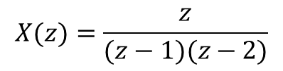


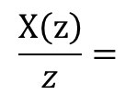



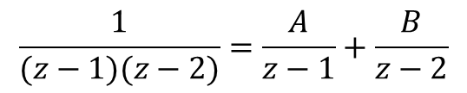
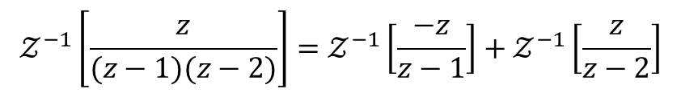
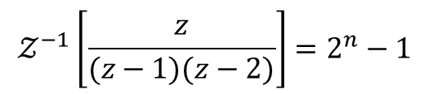
Problem contd…
$$\frac{X\left(z\right)}{z}=$$
$$\frac{1}{(z−1)(z−2)}=\frac{−1}{z−1}+\frac{1}{z−2}$$
$$X(z)=\frac{z}{(z−1)(z−2)}$$
$$X\left(z\right)=\frac{−z}{z−1}+\frac{z}{z−2}$$
$$\frac{X(z)}{z}=\frac{1}{(z−1)(z−2)}$$
$$𝒵^{−1}\left[\frac{z}{(z−1)(z−2)}\right]=𝒵^{−1}\left[\frac{−z}{z−1}\right]+𝒵^{−1}\left[\frac{z}{z−2}\right]$$
$$\frac{1}{(z−1)(z−2)}=\frac{A}{z−1}+\frac{B}{z−2}$$
$$=−𝒵^{−1}\left[\frac{z}{z−1}\right]+𝒵^{−1}\left[\frac{z}{z−2}\right]$$
$$1=A\left(z−2\right)+B(z−1)$$
$$=−{\left(1\right)}^{n}+2^{n}$$
$$A=−1$$
$$𝒵^{−1}\left[\frac{z}{(z−1)(z−2)}\right]=2^{n}−1$$
$$B=1$$
$$(1)$$
$$y_{n}=2^{n}−1$$

Slide 7







Problems contd…
Solve the difference equation
$$y_{n}=y_{n−1}+y_{n−2}, y_{0}=1, y_{1}=1$$
Ans:
Given
$$y_{n}=y_{n−1}+y_{n−2}$$
and
$$y_{0}=1, y_{1}=1$$
$$y_{n+2 }=y_{n+1}+y_{n}$$
$$y_{n+2 }−y_{n+1}−y_{n}=0$$
Taking Z Transform on both sides
$$𝒵\{y_{n+2}−y_{n+1}−y_{n}\}=𝒵\{0\}$$
$$𝒵\{y_{n+2}\}−{𝒵\{y}_{n+1}\}−𝒵\{y_{n}\}=0$$
$$z^{2}𝒵\left\{y_{n}\right\}−z^{2}y_{0}−zy_{1}− \left[z𝒵\left\{y_{n}\right\}−zy_{0}\right]−𝒵\left\{y_{n}\right\}=0$$

Slide 8
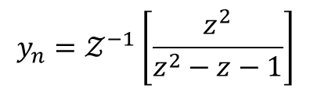
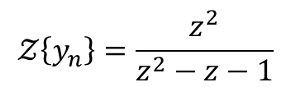


Problems contd…
$$z^{2}𝒵\left\{y_{n}\right\}−z^{2}y_{0}−zy_{1}− \left[z𝒵\left\{y_{n}\right\}−zy_{0}\right]−𝒵\left\{y_{n}\right\}=0$$
$$z^{2}𝒵\left\{y_{n}\right\}−z^{2}−z−z𝒵\left\{y_{n}\right\}+z−𝒵\left\{y_{n}\right\}=0$$
$$z^{2}𝒵\left\{y_{n}\right\}−z𝒵\left\{y_{n}\right\}−𝒵\left\{y_{n}\right\}=z^{2}$$
$$(z^{2}−z−1)𝒵\left\{y_{n}\right\}=z^{2}$$
$$𝒵\left\{y_{n}\right\}=\frac{z^{2}}{z^{2}−z−1}$$
$$y_{n}=𝒵^{−1}\left[\frac{z^{2}}{z^{2}−z−1}\right]$$
$$(1)$$

Slide 9
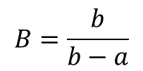

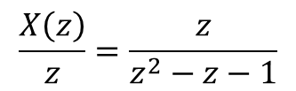



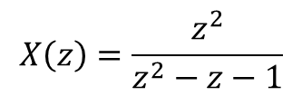


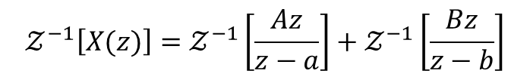
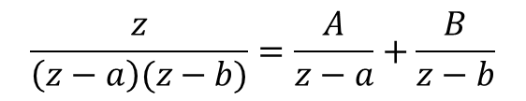

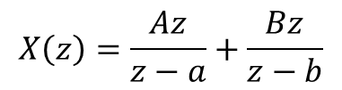
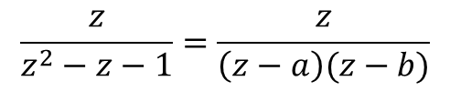
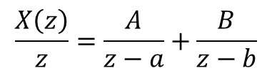
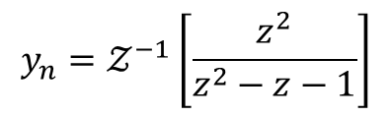
Problems contd…
$$X\left(z\right)=\frac{z^{2}}{z^{2}−z−1}$$
$$\frac{X\left(z\right)}{z}=\frac{A}{z−a}+\frac{B}{z−b}$$
$$\frac{X\left(z\right)}{z}=\frac{z}{z^{2}−z−1}$$
$$X\left(z\right)=\frac{Az}{z−a}+\frac{Bz}{z−b}$$
$$\frac{z}{z^{2}−z−1}=\frac{z}{\left(z−a\right)(z−b)}$$
$$𝒵^{−1}\left[X(z)\right]=𝒵^{−1}\left[\frac{Az}{z−a}\right]+𝒵^{−1}\left[\frac{Bz}{z−b}\right]$$
$$\frac{z}{\left(z−a\right)(z−b)}=\frac{A}{z−a}+\frac{B}{z−b}$$
$$=Aa^{n}+Bb^{n}$$
$$(1)$$
becomes
$$z=A\left(z−b\right)+B(z−a)$$
$$y_{n}=𝒵^{−1}\left[\frac{z^{2}}{z^{2}−z−1}\right]$$
$$A=\frac{a}{a−b}$$
$$y_{n}=𝒵^{−1}\left[X(z)\right]$$
$$B=\frac{b}{b−a}$$
$$y_{n}=Aa^{n}+Bb^{n}$$
$$(2)$$

Slide 10

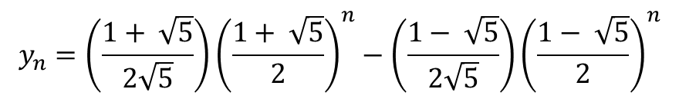
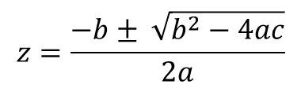



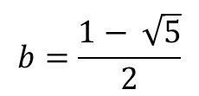

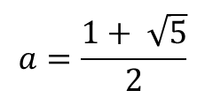
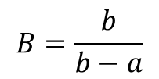
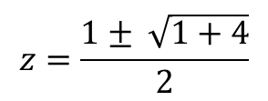

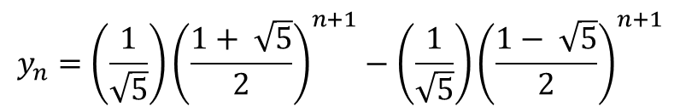
Problems contd…
$$A=\frac{a}{a−b}$$
$$z^{2}−z−1$$
$$B=\frac{b}{b−a}$$
$$z=\frac{−b± \sqrt{b^{2}−4ac}}{2a}$$
$$z=\frac{1± \sqrt{1+4}}{2}$$
$$a−b=\sqrt{5}$$
$$b−a=−\sqrt{5}$$
$$a=\frac{1+ \sqrt{5}}{2}$$
$$b=\frac{1− \sqrt{5}}{2}$$
$$(2)$$
becomes
$$y_{n}=Aa^{n}+Bb^{n}$$
$$y_{n}=\left(\frac{1}{\sqrt{5}}\right){\left(\frac{1+ \sqrt{5}}{2}\right)}^{n+1}−\left(\frac{1}{\sqrt{5}}\right){\left(\frac{1− \sqrt{5}}{2}\right)}^{n+1}$$
$$y_{n}=\left(\frac{1+ \sqrt{5}}{2\sqrt{5}}\right){\left(\frac{1+ \sqrt{5}}{2}\right)}^{n}−\left(\frac{1− \sqrt{5}}{2\sqrt{5}}\right){\left(\frac{1− \sqrt{5}}{2}\right)}^{n}$$

Slide 11


Problems for practice
Solve the following using Z Transform
(1)
$y_{n+1}+y_{n}=1, y_{0}=0$
(2)
$y_{n+2}+6y_{n+1}+9y_{n}=2^{n}, y_{0}=0, y_{1}=0$
$y_{n+2}+y_{n}=5 .2^{n}, y_{0}=1, y_{1}=0$
(3)
(4)
$y_{n+2}−76y_{n+1}+12y_{n}=2^{n}, y_{0}=0, y_{1}=0$
(5)
$y_{n+2}+5y_{n+1}+6y_{n}=2^{n}, y_{0}=0, y_{1}=0$

Slide 12


